Slide 1
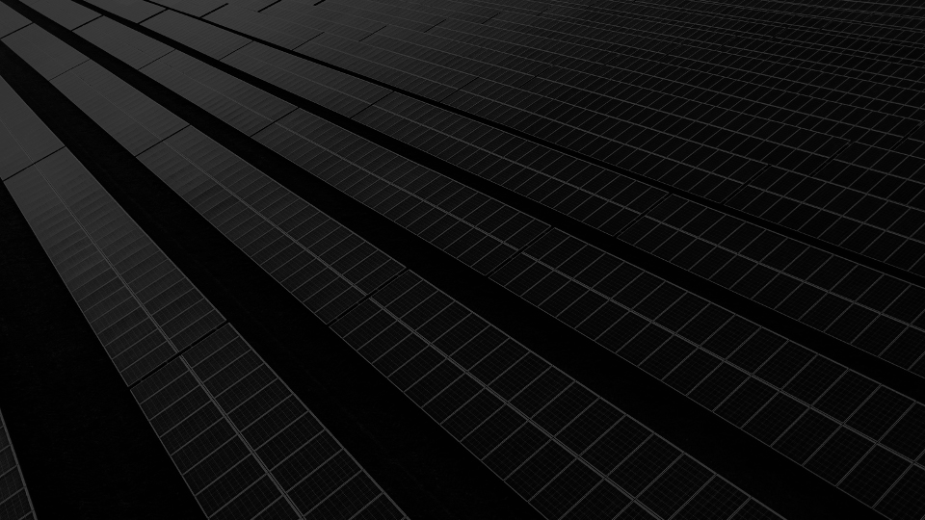
RENEWABLE/UTILITY - BESS
TARGETED SOLUTIONS – CCF & CONNECTIVITY

Slide 2

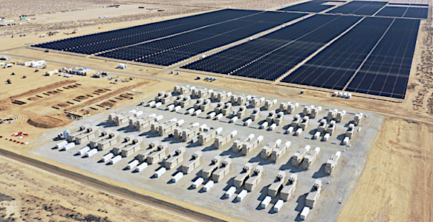
RENEWABLE/UTILITY - BESS
RENEWABLE/UTILITY BESS
OVERVIEW
Introduction - What is BESS?
Las Vegas Trip Review
Targeted Products
Market Intelligence

Slide 3
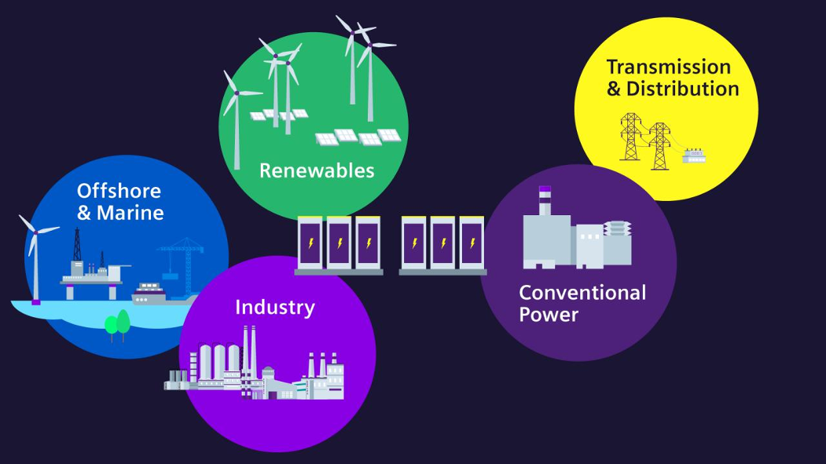
RENEWABLE/UTILITY - BESS
INTRODUCTION - WHAT IS BESS?
BESS – Battery Energy Storage System
AKA – stationary accumulators
Range in size/capacity from residential to full scale utility
Used as power cell for ancillary services
Used to balance power creation vs consumption
Load shedding, grid stabilization
Reference - Siemens BESS

Slide 4
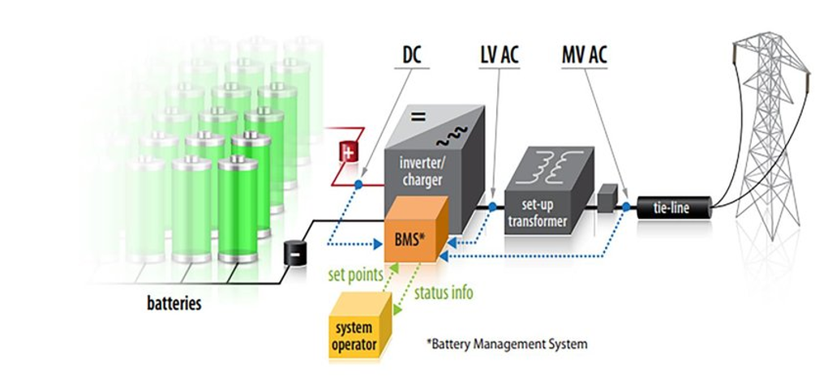
RENEWABLE/UTILITY - BESS
INTRODUCTION –
WHAT IS BESS?
Main components of BESS
Power electronics
Battery management system
Metering/Communications
Link to grid/load

Slide 5
RENEWABLE/UTILITY - BESS
LAS VEGAS TRIP REVIEW
Met w/ RES Group at Silver Peak BESS & Substation
NSI Team:
Chris DeCesare
Patrick McLean
Bryson Allen
Product Overview & Demo
Site tour
Utility Connected Tesla BESS site with 306 battery containers and a substation that is grid connected at 230kV

Slide 6
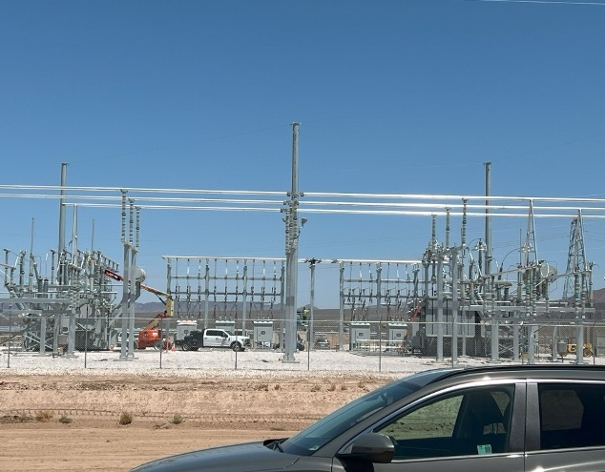
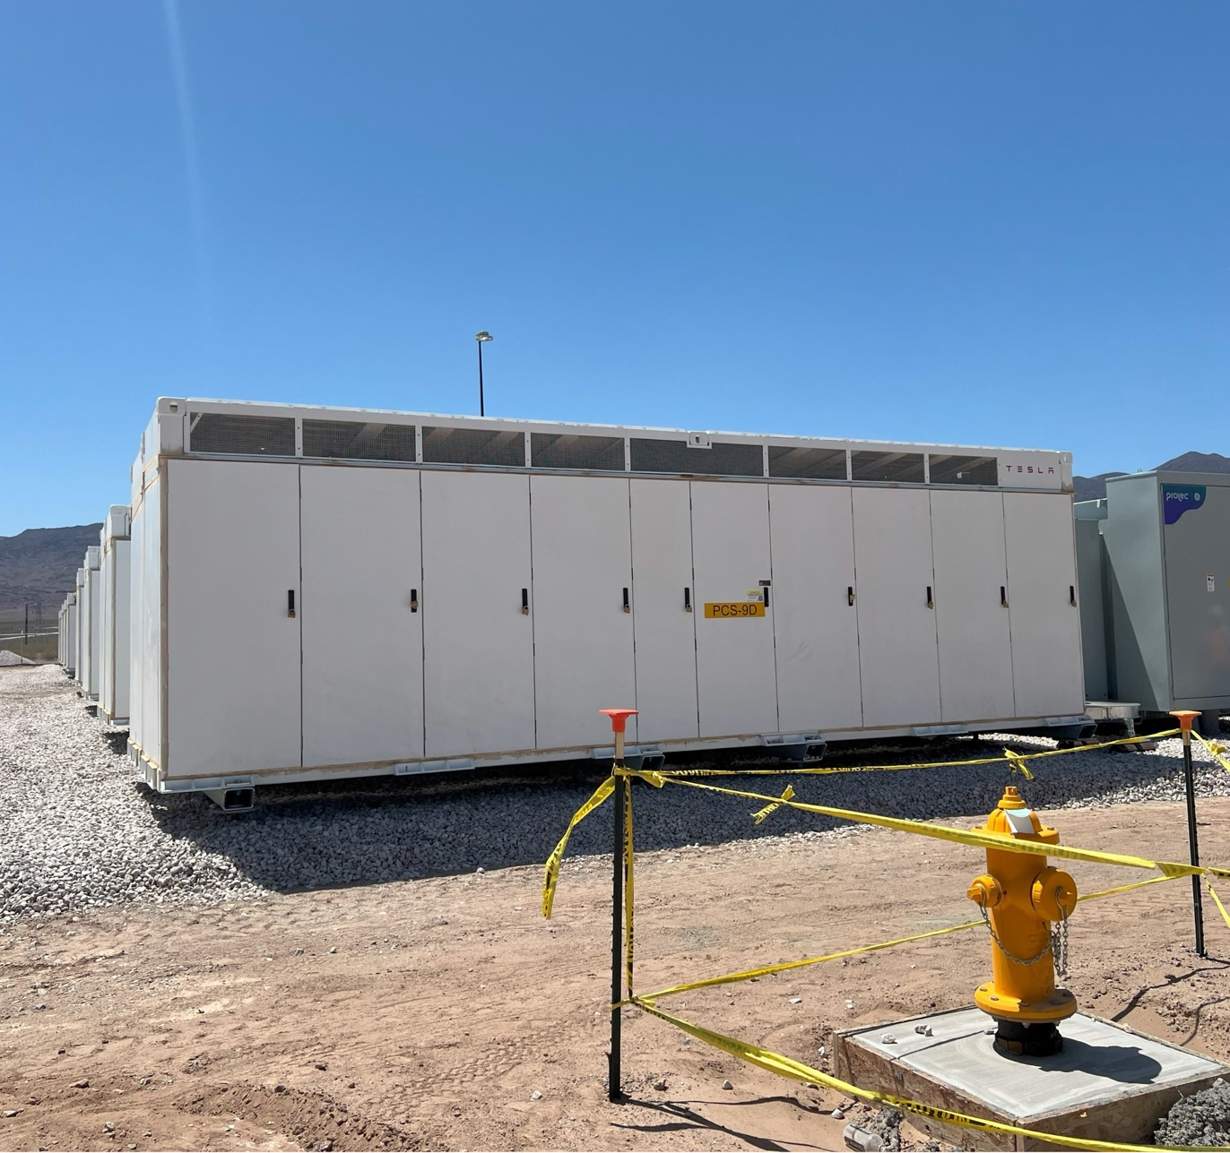
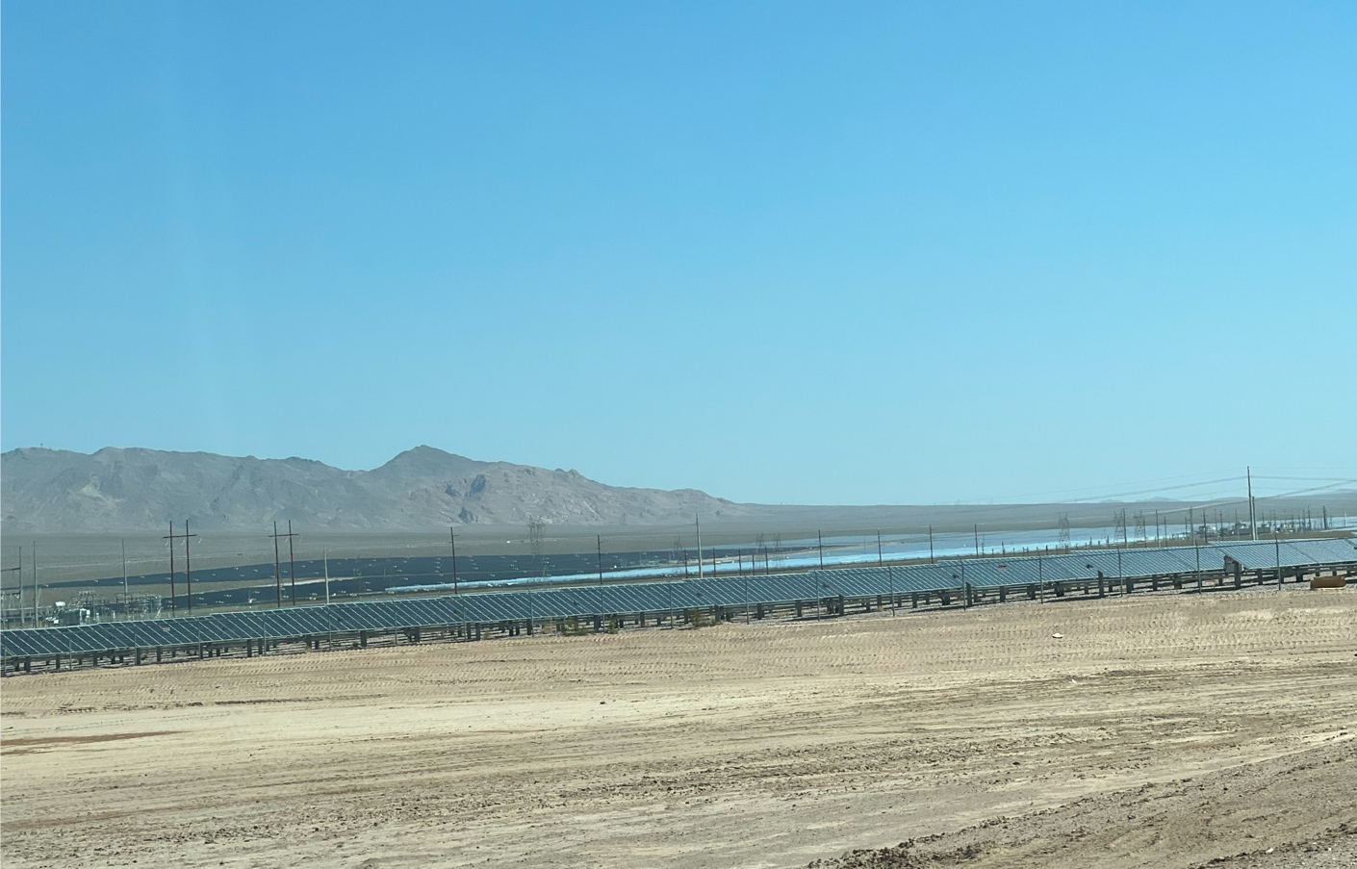
RENEWABLE/UTILITY - BESS
LAS VEGAS TRIP REVIEW
MET W/ RES GROUP AT SILVER PEAK BESS & SUBSTATION
Utility Connected Tesla BESS site with 306 battery containers and a substation that is grid connected at 230kV
Significant market for existing CCF and Connectivity offering

Slide 7

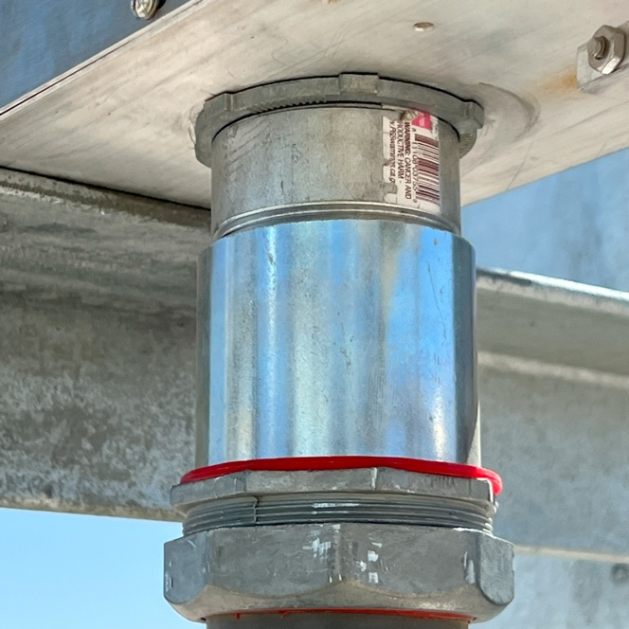
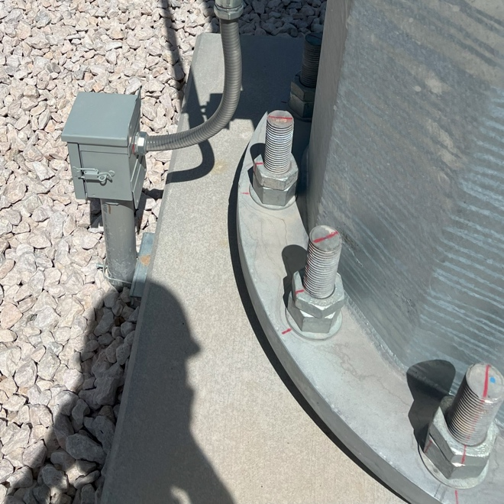
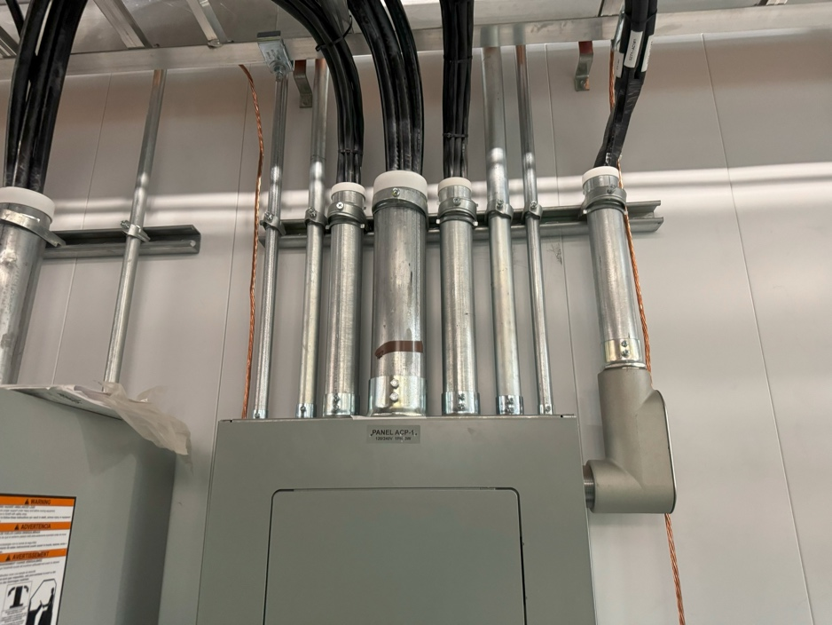
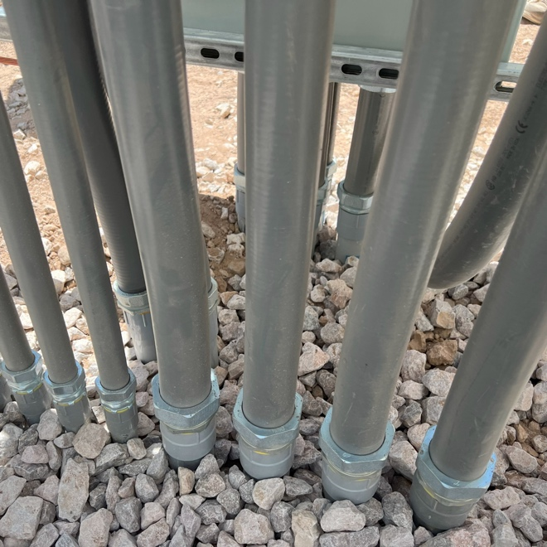
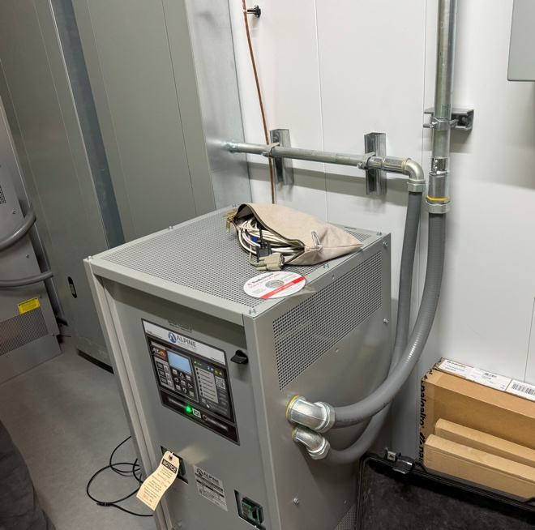
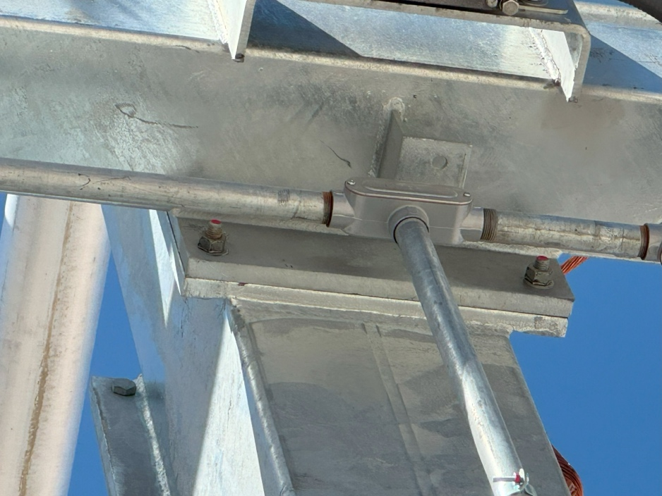
RENEWABLE/UTILITY - BESS
LAS VEGAS TRIP REVIEW
LIQUIDTIGHT TRANSITIONS
(436X-DC SERIES)
EMT (dry location) & rigid (wet location) fittings,
Conduit bodies and sealing reducing washers

Slide 8
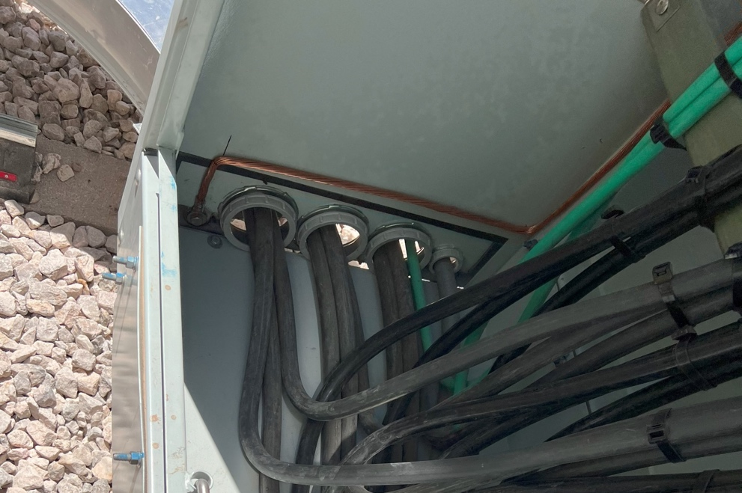
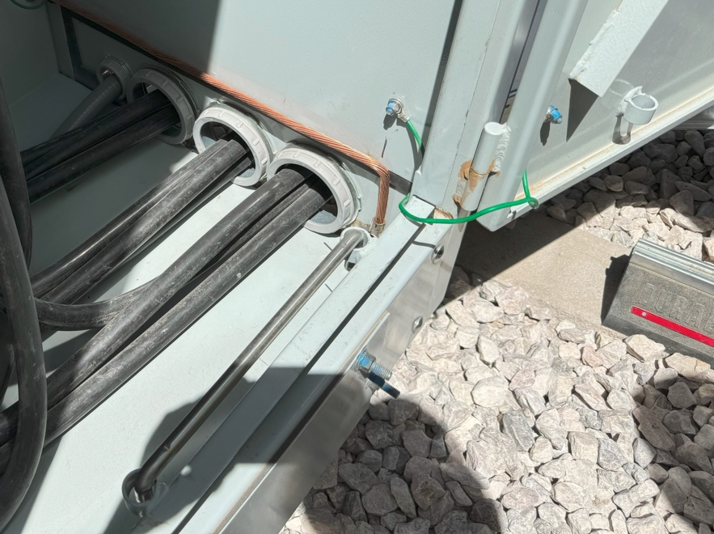
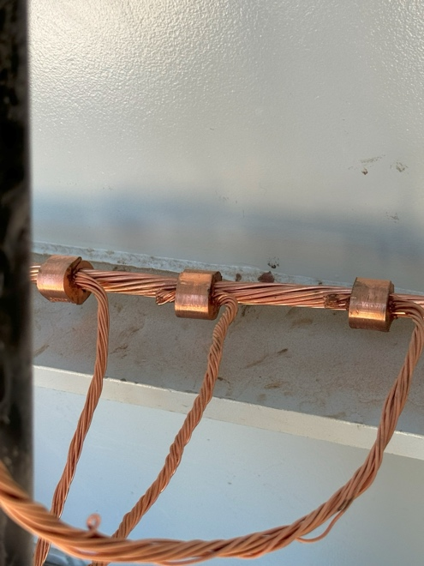
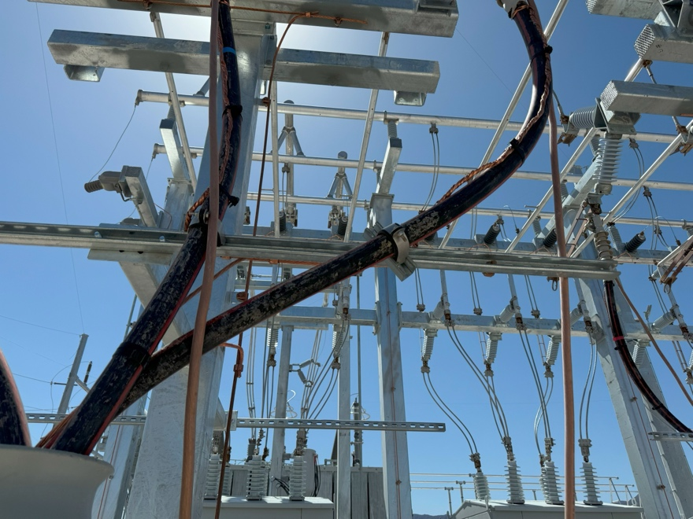
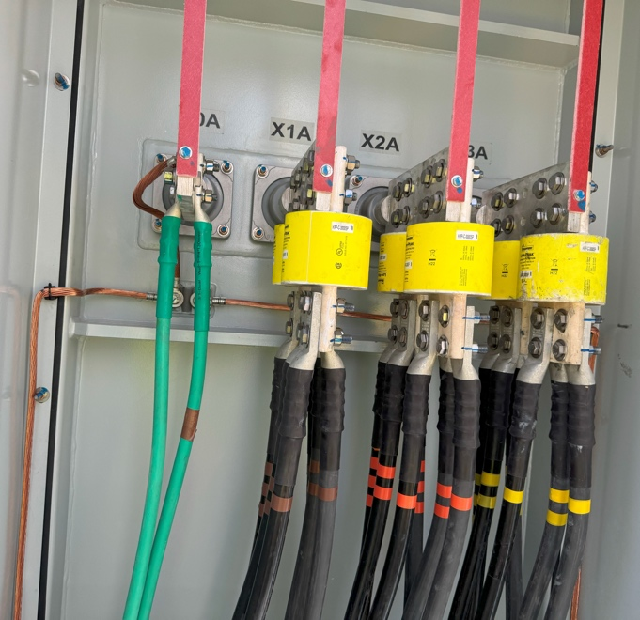
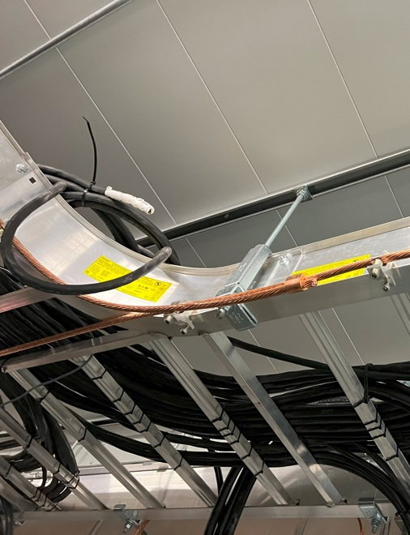
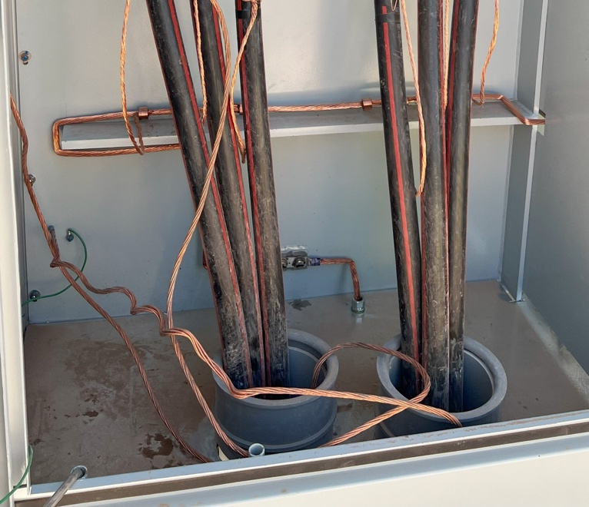
RENEWABLE/UTILITY - BESS
LAS VEGAS TRIP REVIEW
PVC
Plastic Split Bushings
CONNECTIVITY
Compression Connectors, C-Shape Taps & other grounding clamps

Slide 9
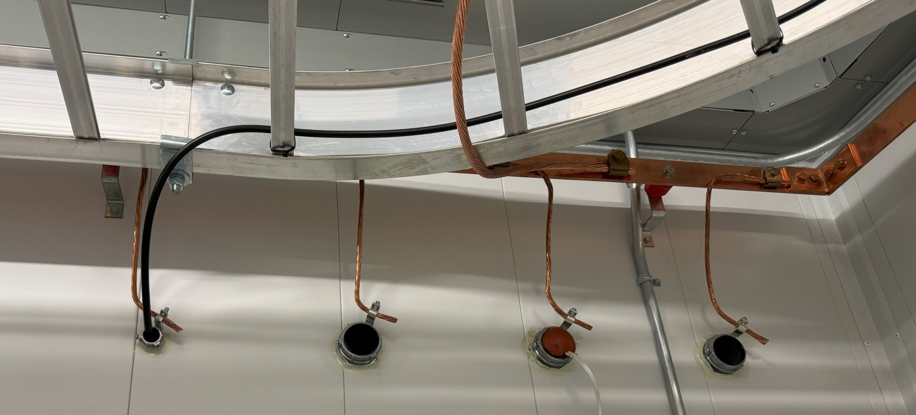
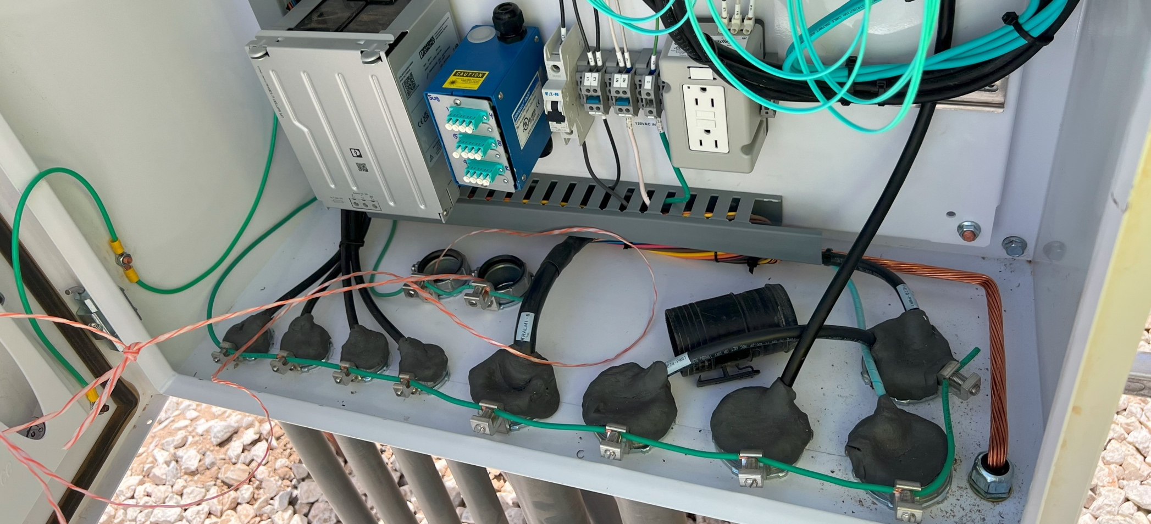
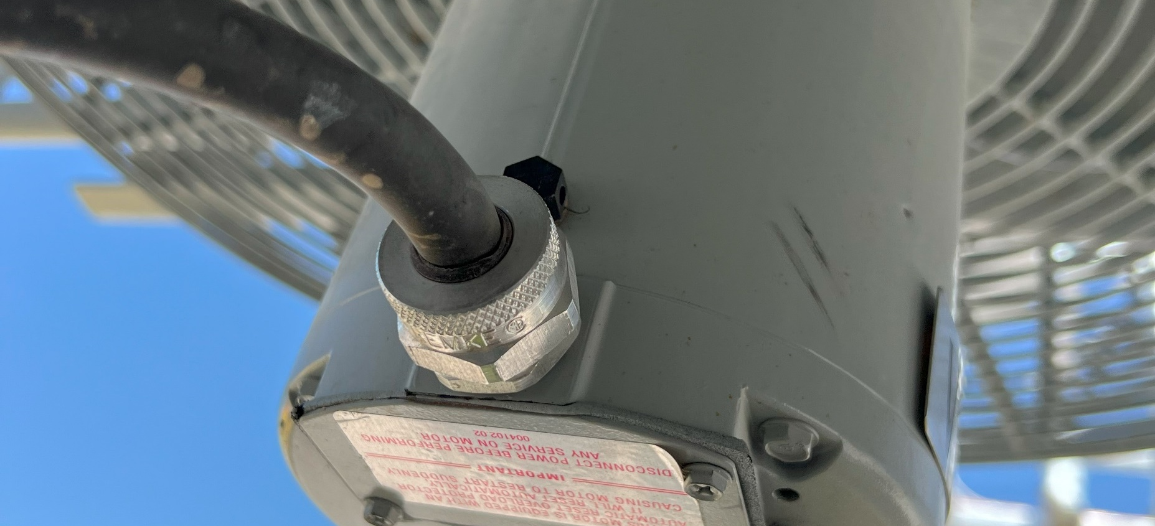
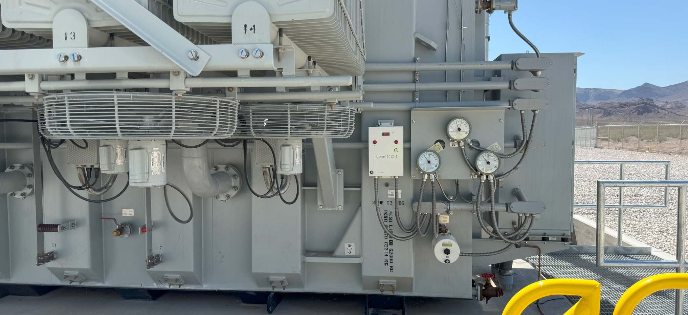
GROUNDING BUSHINGS (38X-DC SERIES)
LOCKNUTS (16X-G SERIES)
CORD GRIPS (REMKE RSR SERIES)
CORD GRIPS (REMKE RSR SERIES)

Slide 10
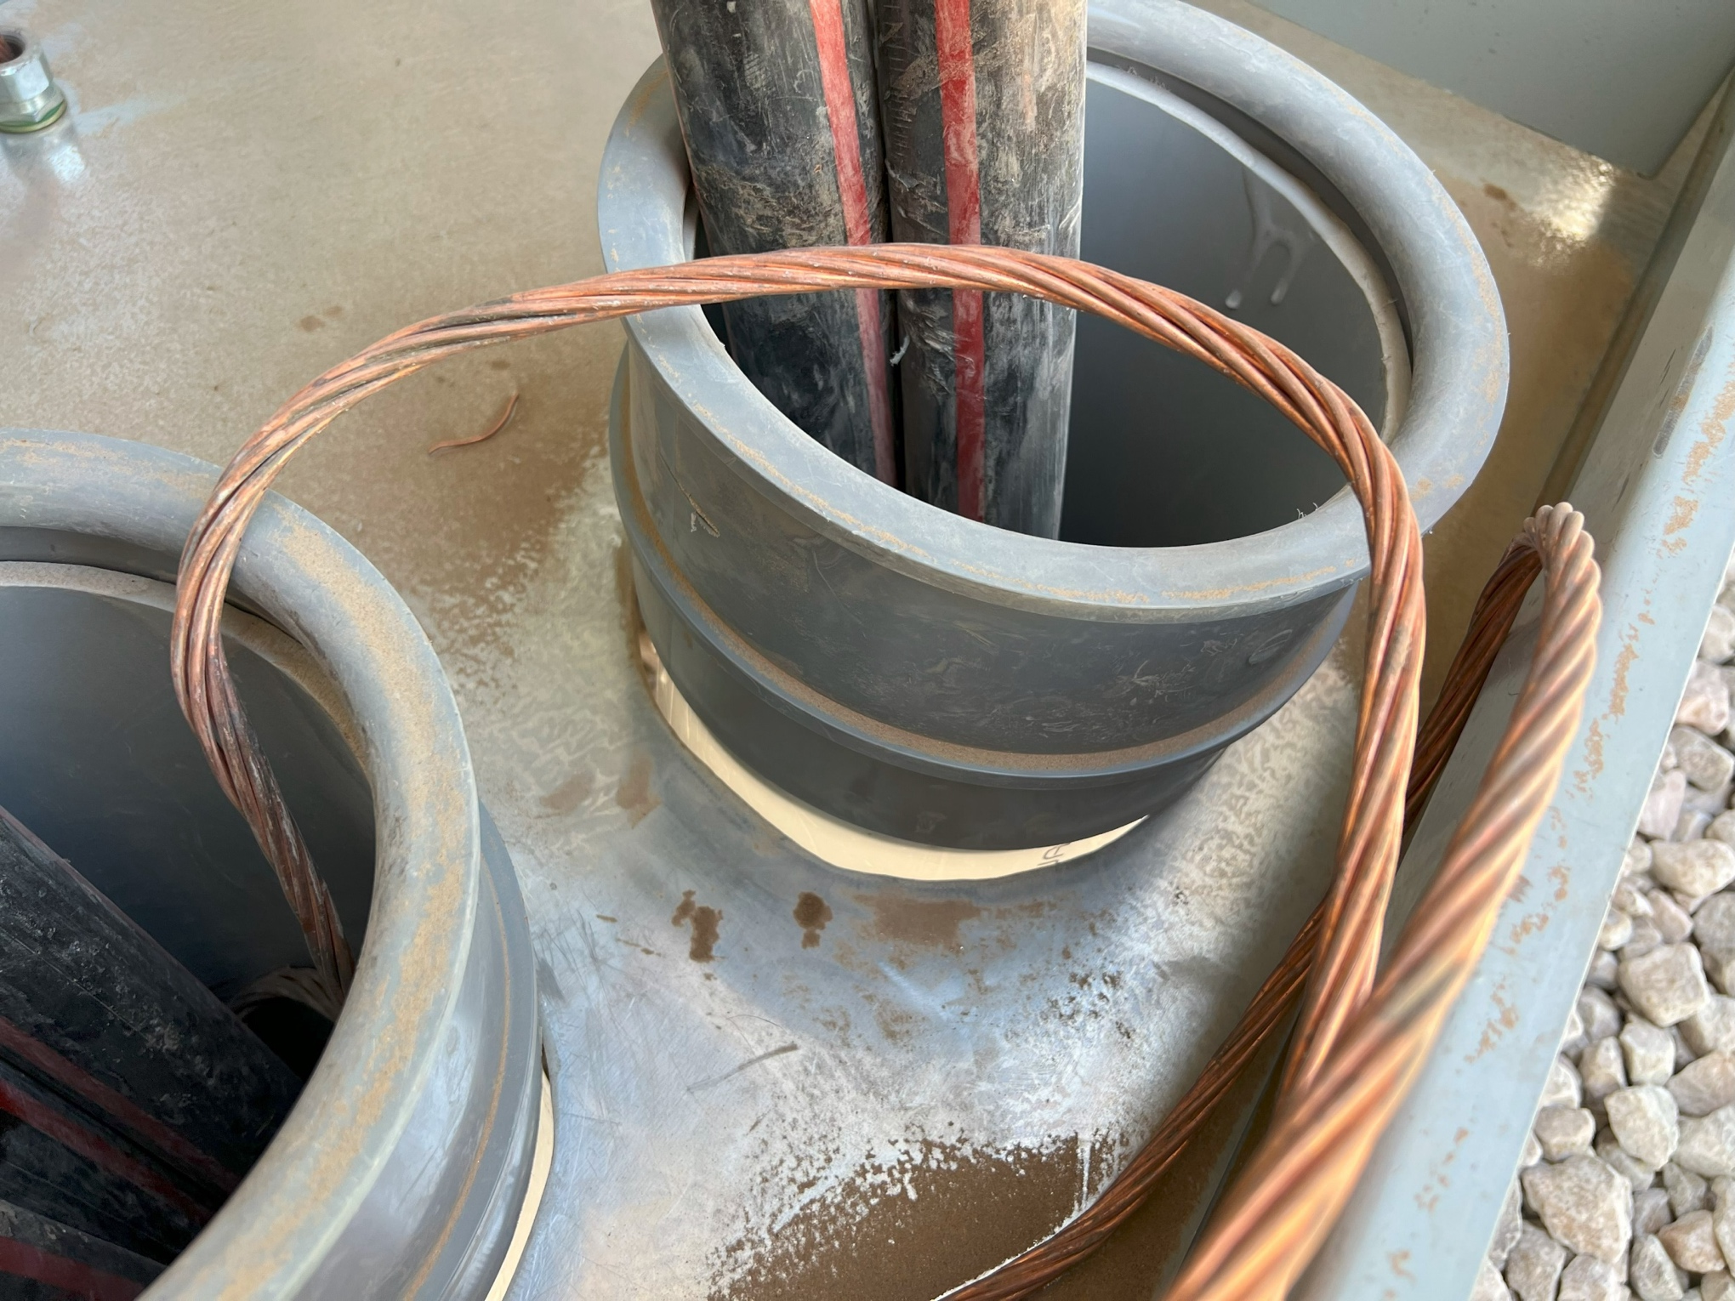
RENEWABLE/UTILITY - BESS
LAS VEGAS TRIP REVIEW
NEW PRODUCT DISCOVERY
Large Trade Size Threadless PVC Conduit Connector

Slide 11
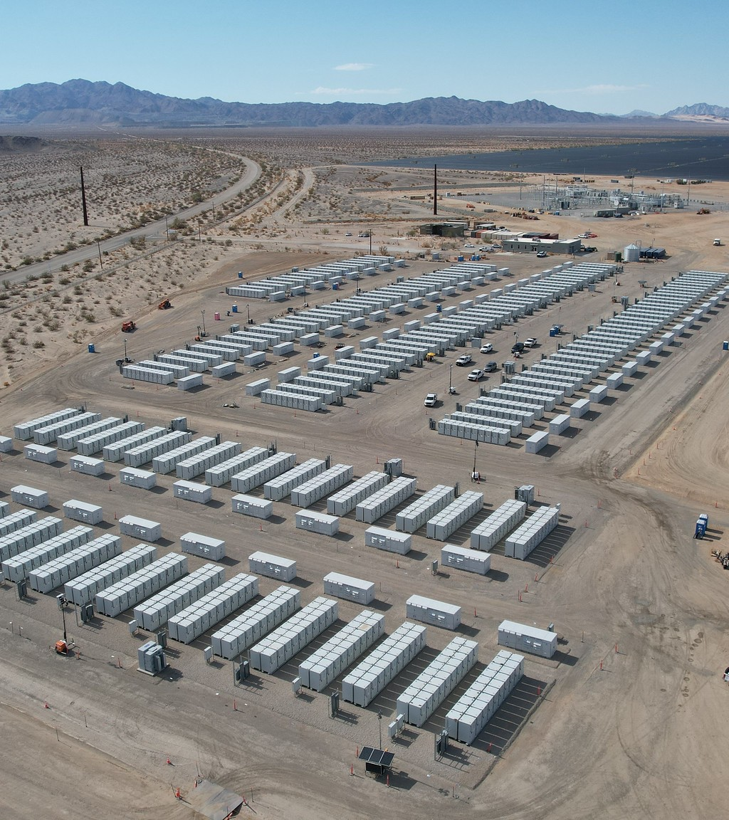
RENEWABLE/UTILITY - BESS
LAS VEGAS TRIP REVIEW
TARGETED
PRODUCTS
Transition Fittings
Conduit Bodies
Grounding Bushings
Rigid & EMT Fittings
Cord Grips
Compression Lugs & Grounding

Slide 12
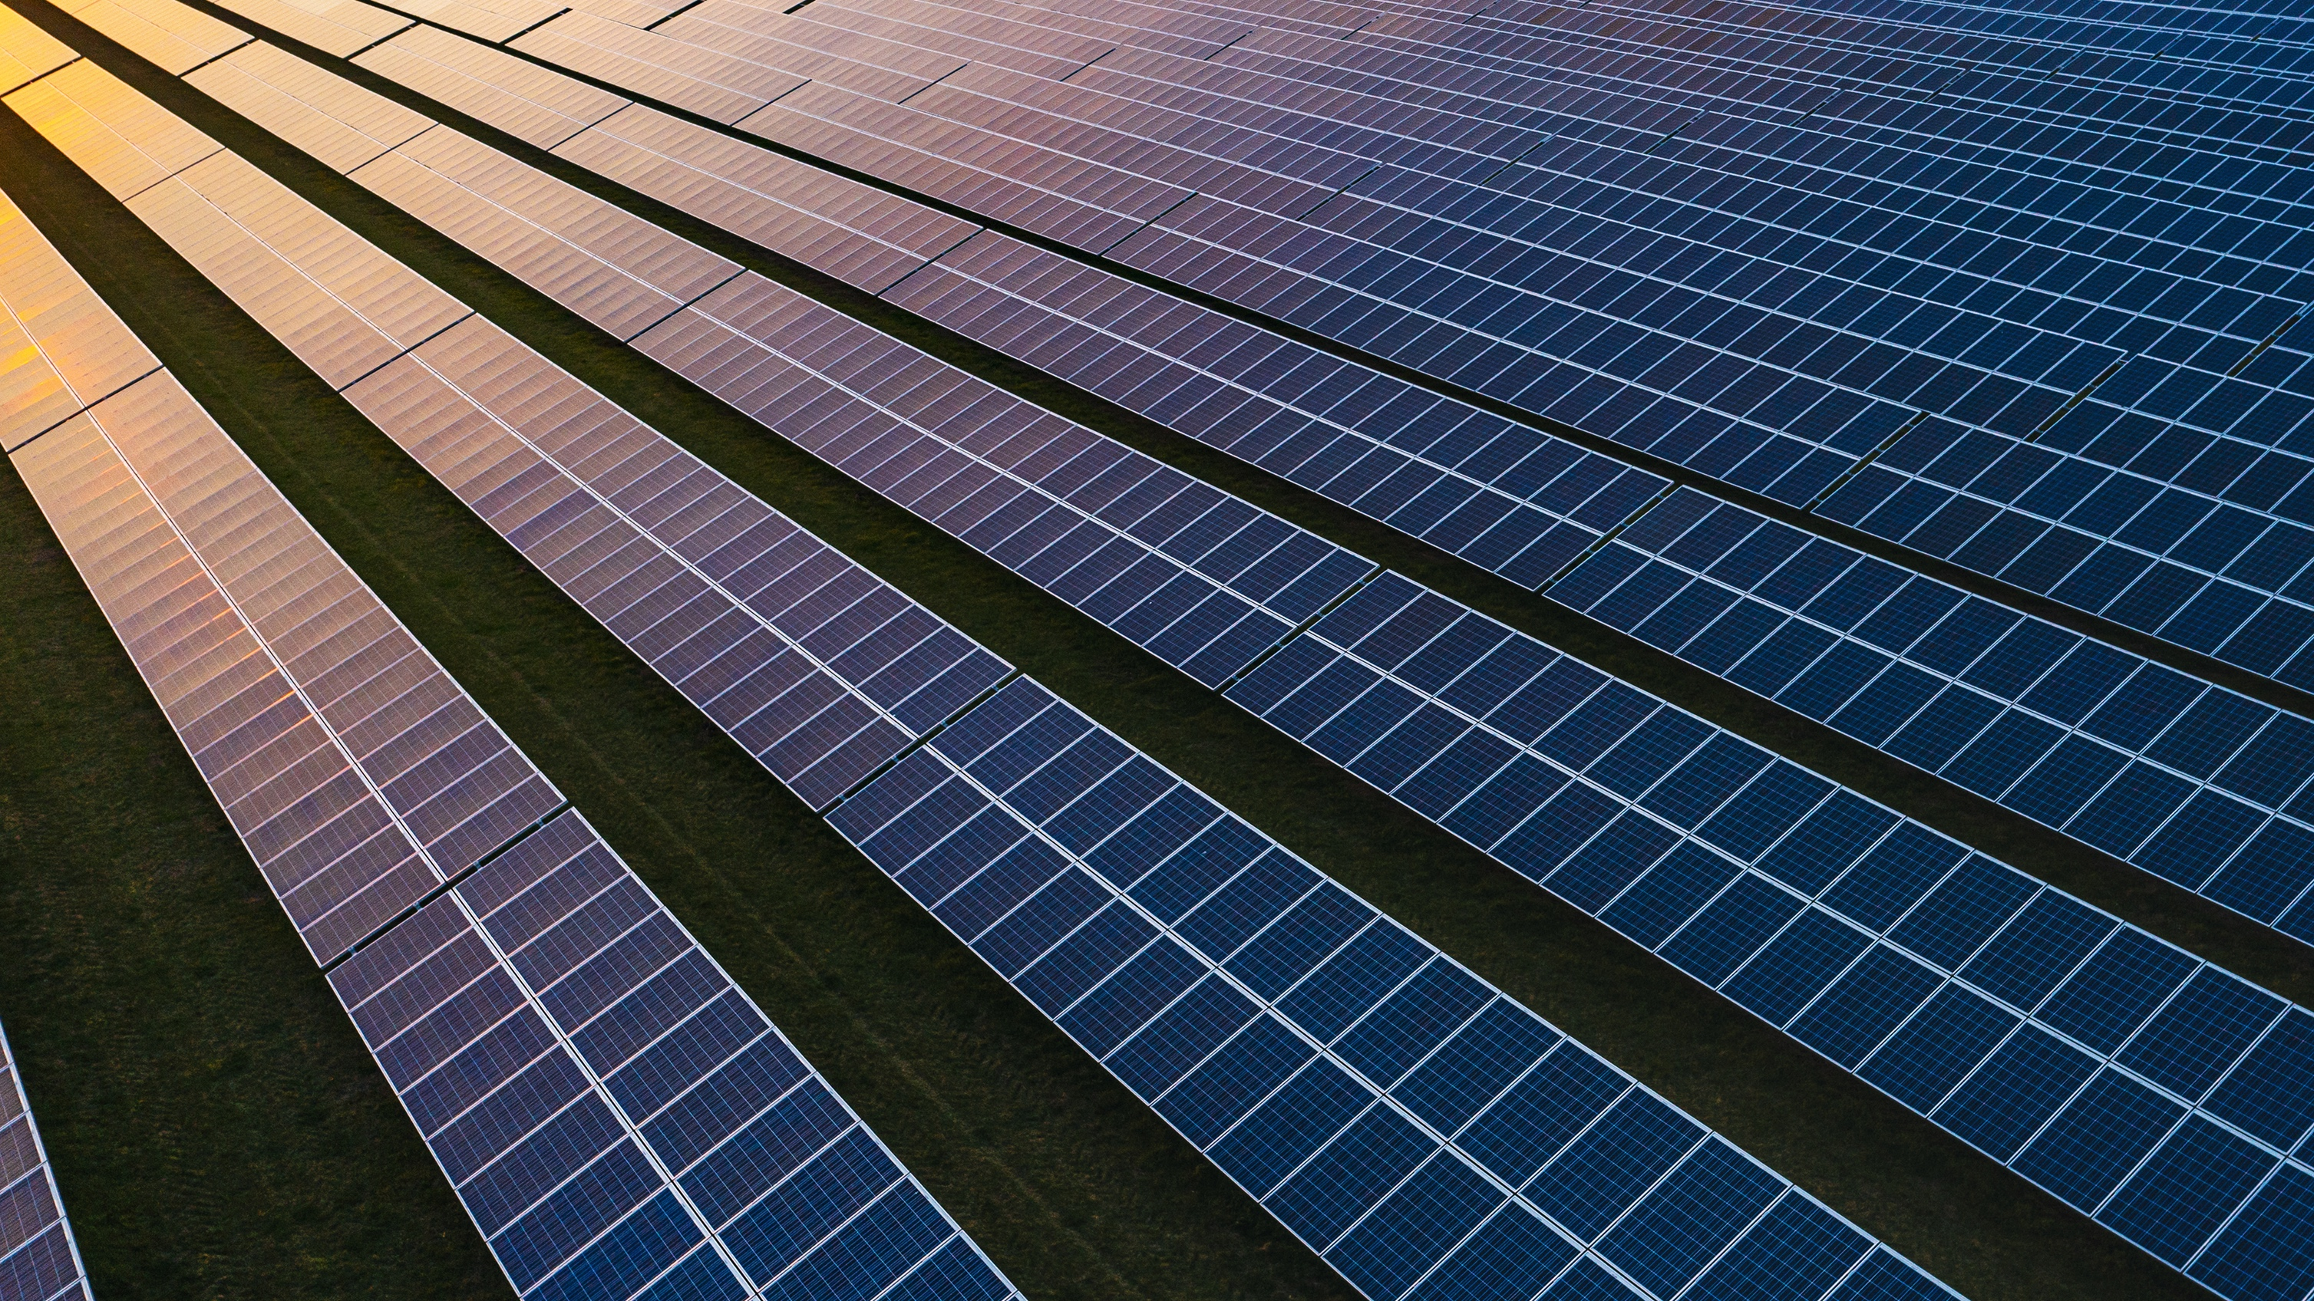
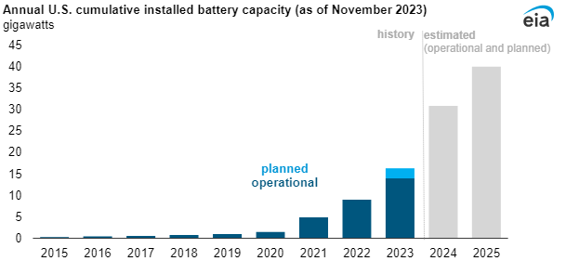
MARKET INTELLIGENCE
RES has 4 projects of similar size in North America
300+ utility-scale battery storage projects on line in the United States by 2025, and around 50% will be in Texas. The five largest new U.S. battery storage projects that are scheduled to be deployed in California and Texas in 2024 or 2025 are:
Lunis Creek BESS SLF (TX, 621 MW)
Clear Fork Creek BESS SLF (TX, 600 MW)
Hecate Energy Ramsey Storage (TX, 500 MW)
Bellefield Solar and Energy Storage Farm (CA, 500 MW)
Dogwood Creek Solar and BESS (TX, 443 MW)
EIA Article

Slide 13


